Slide 1
Analyzing Load Profiles of Energy Consumption to Infer Household Characteristics Using Smart Meters
Muhammad Fahim, Alberto Sillitti
Institute of Information Systems, Innopolis University
MDPI Energies 2019
311551045 劉耀文

Slide 2
Outline
Introduction
Related Work
Method
Result and Discussion
Conclusion

Slide 3
Introduction
A significant portion of CO2 emissions comes from the energy consumption of buildings.
50 ~ 65% of energy consumption is in the form of electricity
electrical appliances, lightning, heating, and cooling systems
large amount of energy is wasted in both residential and commercial buildings
possible to optimize the electricity usage if we know detailed household information

Slide 4
Introduction
To provide household characteristics, a relevant amount of effort and money is required to perform surveys.
very difficult to keep the information up-to-date
infer household characteristics automatically by analyzing the smart meter energy consumption logs
provide univariate time-series data streams about the energy consumption inside buildings
no additional information to train machine learning models
a huge amount of data is generated
measure the energy consumption for every 6 ~ 8 seconds

Slide 5
Introduction
Log analysis has four different levels
long-term analysis (with a timeframe of years)
medium-term analysis (timeframe of months)
Choose this to reduce the computation cost of data processing
short-term analysis (timeframe of weeks)
very short-term analysis (timeframe of days or hours)

Slide 6
Introduction
The framework provide unique insights of electricity consumption by revealing the information about household characteristics.
The characteristics are related to a household’s socio-economic status.
home appliances, number of inhabitants, employment status
identify the relationship between energy consumption and household characteristics
predict future energy demands
demographics and population statistics
Notes:
Demographics 人口統計學

Slide 7
Introduction
The authors processed and analyzed the energy consumption data to answer the following questions.
How many inhabitants are there in the building?
What is the employment status of the inhabitant(s)?
How many electrical appliances are in the building?
How many bedrooms are in the building?

Slide 8
Contribution
This paper developed an open-source framework to impute the household characteristics to determine the energy consumption patterns at residential levels.
Notes:
1. Impute 估計

Slide 9
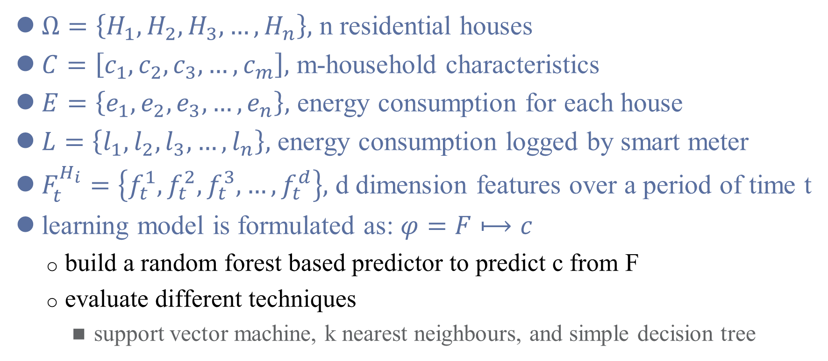
Problem Formulation
$Ω=\left\{H_{1},H_{2},H_{3},…,H_{n}\right\},$ n residential houses
$C=\left[c_{1},c_{2},c_{3},…,c_{m}\right],$ m-household characteristics
$E=\left\{e_{1},e_{2},e_{3},…,e_{n}\right\},$ energy consumption for each house
$L=\left\{l_{1},l_{2},l_{3},…,l_{n}\right\},$ energy consumption logged by smart meter
$F_{t}^{H_{i}}=\left\{f_{t}^{1},f_{t}^{2},f_{t}^{3},…,f_{t}^{d}\right\},$ d dimension features over a period of time t
learning model is formulated as: $φ=F⟼c$
build a random forest based predictor to predict c from F
evaluate different techniques
support vector machine, k nearest neighbours, and simple decision tree

Slide 10
Related Work
The research community has already recognized a strong relationship between the household characteristics and household energy consumption.
[4] assessed the viability of determining household characteristics based on electricity consumption using smart meters.
help to summarize the key feature of household load profiles
[15] addressed the importance of household characteristics for predicting the energy consumption.
the analysis of the collected dataset to determine the important features
Notes:
[4] 用多階層回歸 (multi-level regression) 跟探索性因素分析 (exploratory variable) 來找到 household characteristics 跟 electricity consumption 的關係。
費時費力，而且需要探索性因素分析的專業知識
[15] 用了 random forest 來預測，他們的主要貢獻在於分析蒐集到的資料並找出重要的 feature。

Slide 11
Related Work
(cont.)
[16] extracted the features from the survey data as well as processed the smart meter data for working days only.
[17] and [12] used clustering to classify the electricity customers.
[10] introduced a framework to automatically classify the socio-economic household’s characteristics using electricity consumption data.
Notes:
[16] 主要適用 decision tree 來預測新的顧客屬於哪一種種類
[17] focused on clustering and self-organizing maps (SOM)
The drawback of this methodology is the need of user-defined thresholds for the
identification of clusters and required post-processing of the results to form the clusters.
[12] their study also concludes that such characteristics are important to support better methods for demand-side management.
[10] they defined comprehensive feature set
consumption, ratios of consumption, features related to temporal dynamics(時間動態), statistical properties, first ten principal components PCA
[10] they also used four different types of classifiers
kNN, LDA, Mahalanobis, SVM

Slide 12
Related Work
The authors’ proposed architecture extends the current state of the art to infer household characteristics.
helpful for forecasting energy consumption loads
developing of strategies to reduce energy consumption
extracting features automatically without involving domain expertise or any knowledge about the domain

Slide 13
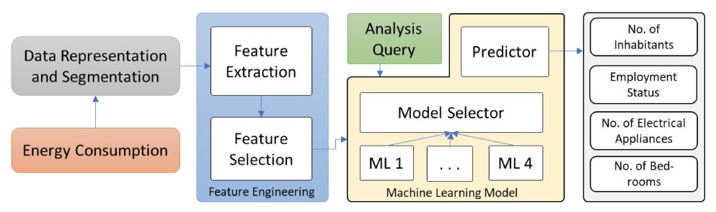
Method
The proposed architecture includes four major components
Data Representation and Segmentation
Features Engineering
Analysis Query
Machine Learning Model

Slide 14
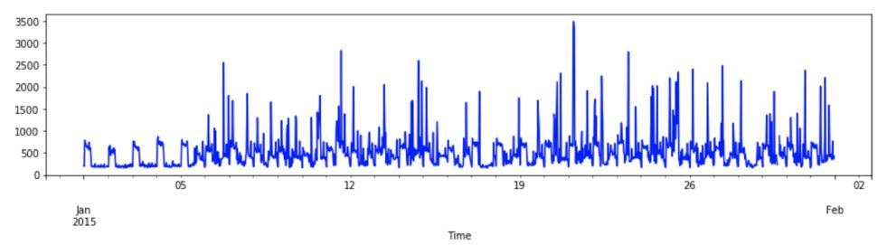
Data Representation and Segmentation
The data representation window (also known as a segmentation window) is defined as 30 min.

Slide 15
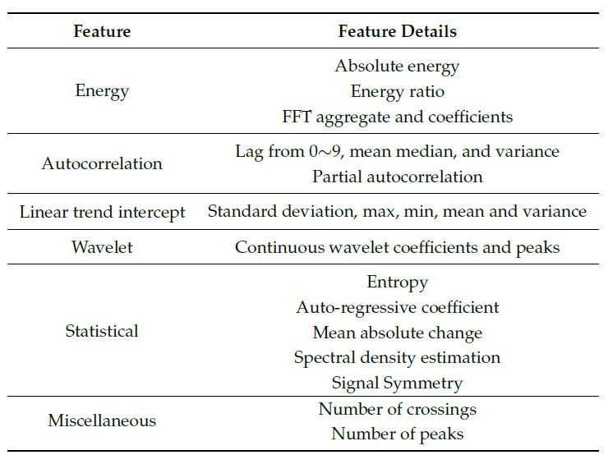
Feature Engineering
The paper used a time-series feature extraction library based on scalable hypothesis tests (also known as TSFRESH).
Find the quantitative characteristics of time-series data and indicates the dynamics of energy usage.
Extracted features assist the machine learning model to predict the inhabitant’s characteristics.

Slide 16
Feature Engineering
The paper also performed feature selection on the basis of automatically configured statistical hypothesis tests.
allows the model to learn more efficiently

Slide 17
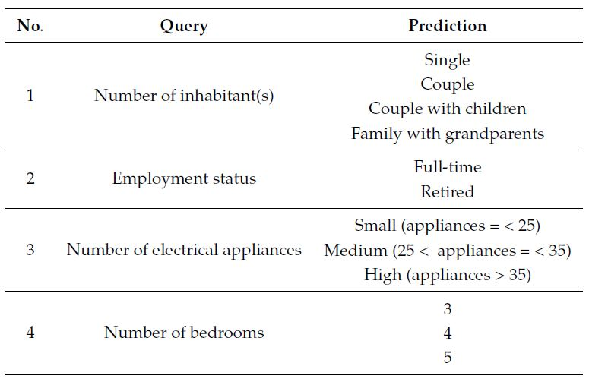
Analysis Query
For the purpose of analyzing the energy consumption data for extracting information, analysts pose high-level queries to understand the consumption patterns in different houses.

Slide 18
Machine Learning Model
Different supervised learning classifiers have been evaluated.
Decision Tree, SVM, Random Forest, K-NN
highly competitive in many application domains and used in many real-life applications
To learn a generalized model, we combine the different residential buildings data which shared the same household characteristics.
Each model is trained on a single query under investigation.
Notes:
第一點，主要會用 random forest 是因為他會因為生成很多 classifier 來分散錯誤風險，所以有比較好的結果
第二點，如果兩個房子都是住兩個人的話，就把他的 household characteristics 設為 couple
第三點，每個 model 都只去預測其中一項 query

Slide 19
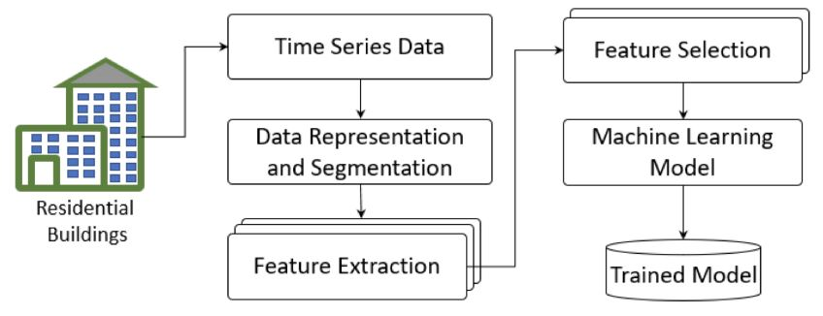
Training Phase
The dataset has been split and the model has been trained on 70% of the dataset and tested over the remaining 30% of data.

Slide 20
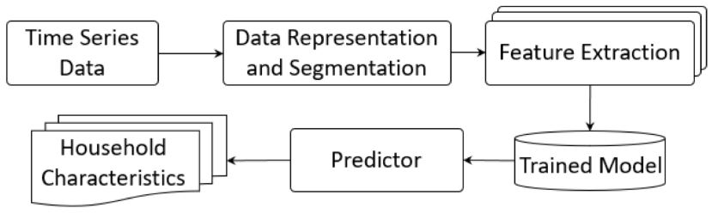
Prediction Phase
In the prediction module, the selection mechanism has been performed on the trained models according to the analyst query and predicted the household characteristics.

Slide 21
Result and Discussion
Dataset
The experiments are performed on an electrical load measurements dataset.
the aggregate loads and individual appliance measurements over the interval of 8 s
collected over a period of two years from 20 houses in the United Kingdom
occupied by single people, couples, couples with children and families with grandparents

Slide 22
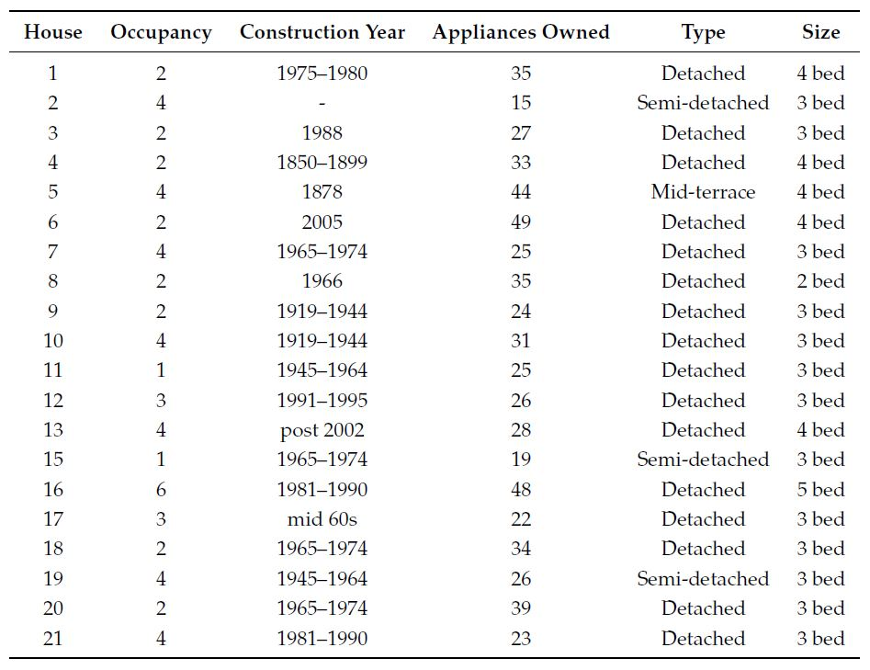
Result and Discussion
Dataset

Slide 23
Result and Discussion
Dataset
They selected one month of smart meter data (i.e., January 2015) of five houses that contain the information about our analysis queries.
house one, two, 11, 12, and 16 according to the dataset files
dataset is imbalanced since there are many houses with only couples or families with kids
use an under sampling technique to deal with the class-imbalance problem
five selected houses covered all the variations in the dataset to predict the inhabitant behavior

Slide 24
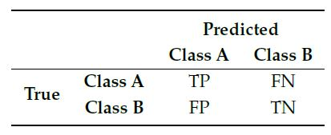
Result and Discussion
Performance Measures
Evaluating the framework has entailed using five standard metrics
Confusion matrix, precision, recall, F1-score and class-accuracy

Slide 25
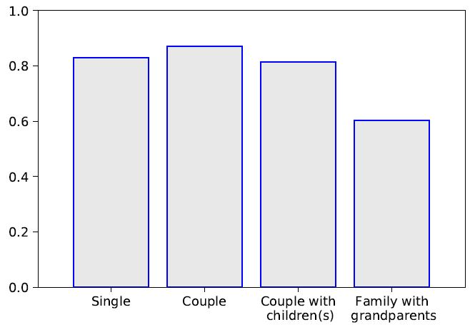
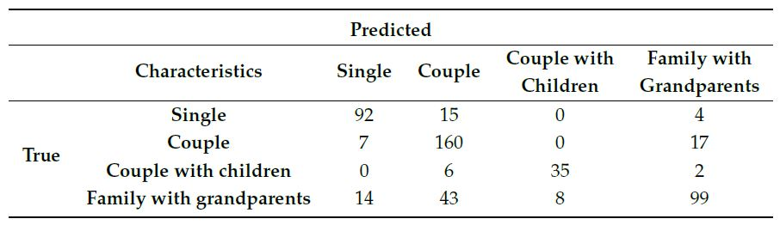
Experiments
Results and Analysis of Query 1
number of inhabitant(s)

Slide 26
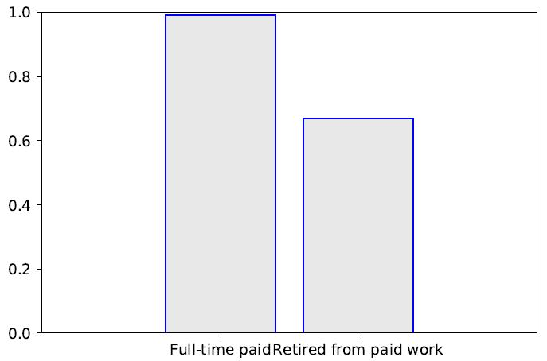
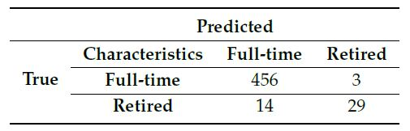
Experiments
Results and Analysis of Query 2
The number of instances for retired is small as compared to full-time.
The learner has insufficient amount of information to learn more accurately.

Slide 27
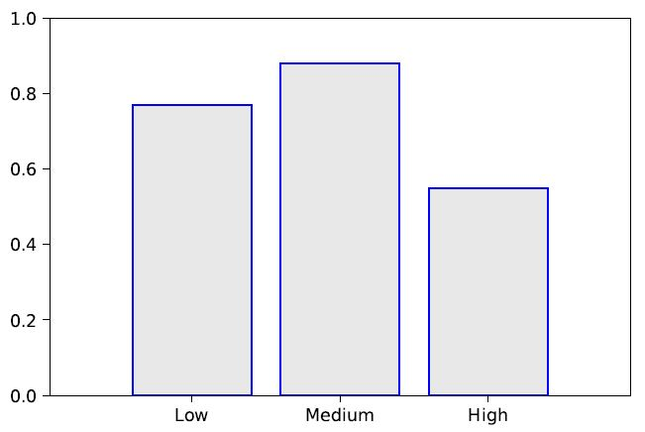
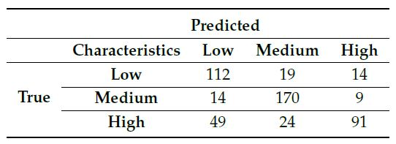
Experiments
Results and Analysis of Query 3
number of electrical appliances

Slide 28
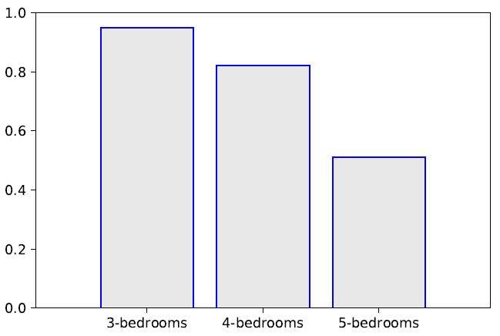
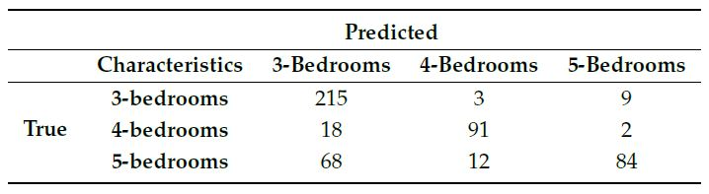
Experiments
Results and Analysis of Query 4
number of bedrooms

Slide 29
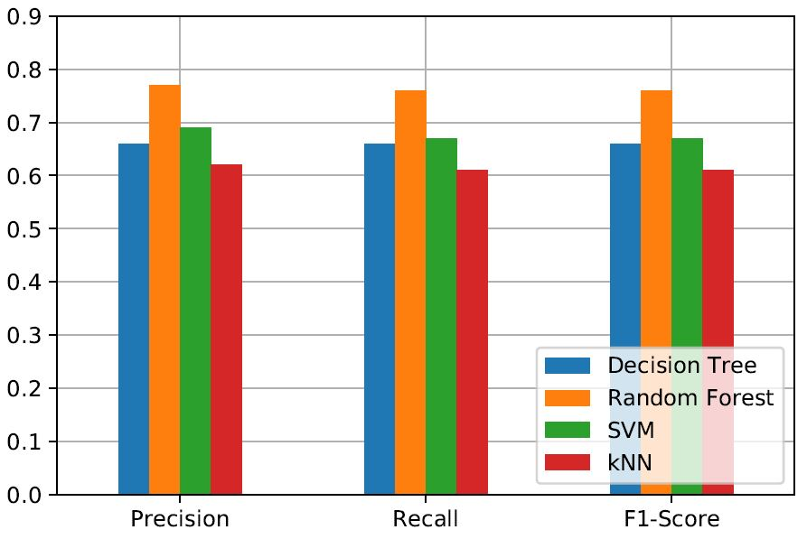
Comparison
Q1—Precision, Recall, and F1-Score to predict the number of inhabitants.

Slide 30
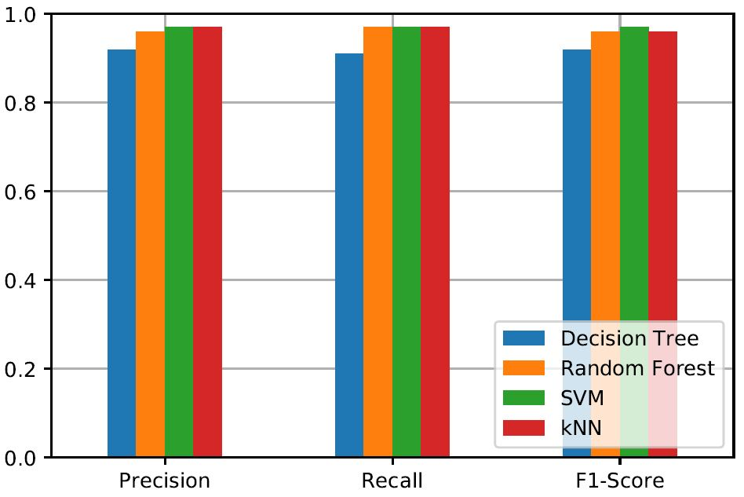
Comparison
Q2—Precision, Recall, and F1-Score to predict the employment status.

Slide 31
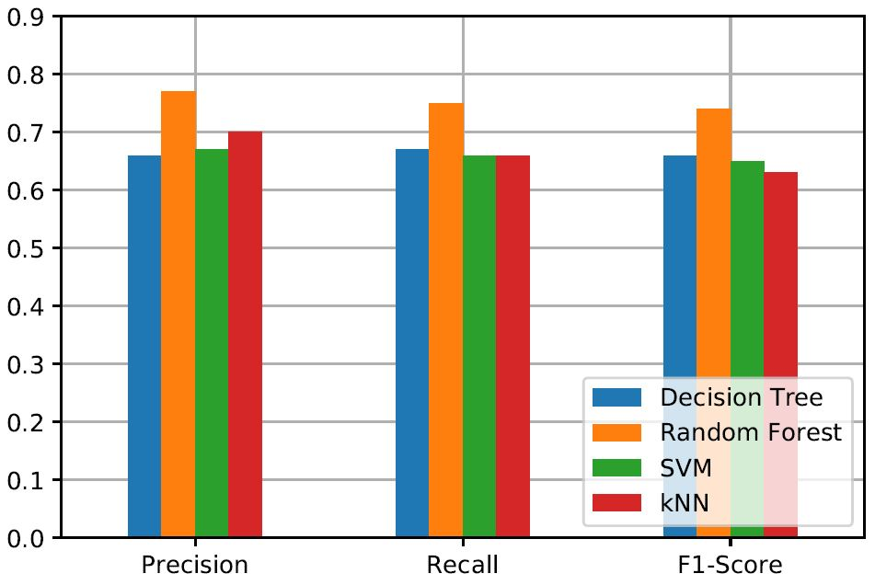
Comparison
Q3—Precision, Recall, and F1-Score to predict the number of electrical appliances.

Slide 32
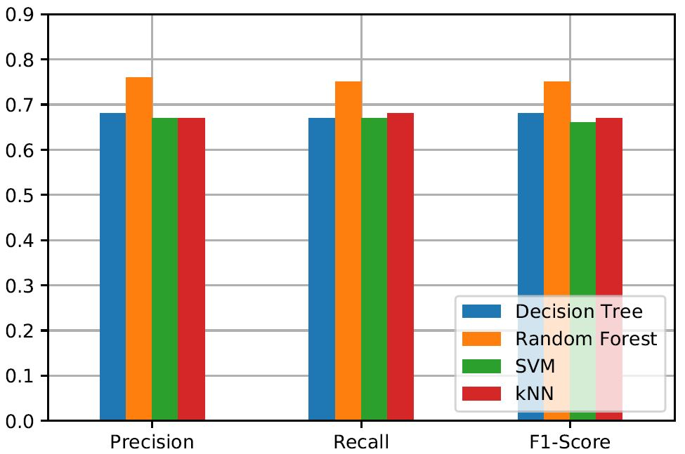
Comparison
Q4—Precision, Recall, and F1-Score to predict the number of bedrooms.

Slide 33
Conclusion
The developed framework is able to infer the household characteristics by analyzing the energy consumption profiles.
number of inhabitants, employment status, electrical appliances, and number of bedrooms
The knowledge of household characteristics is extremely important to introduce energy-saving strategies in residential buildings.
The obtained results are better compared to the state-of-the-art in some specific areas.

Slide 34
Conclusion
The next step in this work is to process high-resolution smart metering data for detecting the most energy hungry devices inside the residential buildings.

Slide 35
Pros & Cons
Pros
Develop a framework that can infer the household characteristic and maybe can develop a house-specific energy strategy.
Compare with different kinds of models that used in previous researches.
Cons
The model might be overfitting while the training data is from small number of house.

